Slide 1
C3 topic3- Active transport
Wenting Chai

Slide 2
Learning objectives
You should be able to:
Define active transport.
Contrast differences between diffusion, osmosis and active transport, limited to energy, direction of movement, types of molecules/ ions moved, specific carrier protein.
Give 2-3 examples of active transport in organisms, e.g. ion uptake by root hairs, uptake of glucose by epithelial cells of villi/ small intestine.

Slide 3
moving UP or against a concentration gradient
ENERGY
High concentration
Low concentration
Active transport occurs across semi permeable membranes and moves particles from a low concentration to a higher concentration. This is against the concentration gradient.

Slide 4
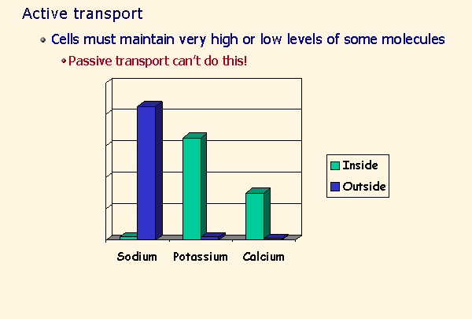
Active transport
One example:

Slide 5
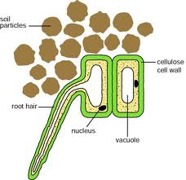
Minerals in plants
Plants make proteins using nitrates they get from the soil .Nitrates are dissolved in water in soil .
the root cell has a higher concentration of Nitrates than the surrounding soil so diffusion is not possible
nitrates and other minerals are taken in via the root cell by a process called Active transport

Slide 6
Active transport
Definition
The movement of molecules and ions in or out of a cell through the cell membrane,
against a concentration gradient,
using energy from respiration,
with help from specific transport proteins.

Slide 7
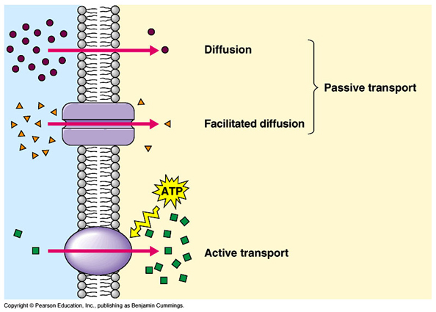

Slide 8
Active transport
Very often, the concentration of nitrate ions inside the root hair cell is higher than the concentration in the soil.
Despite this, the root hair cells still need to take in nitrate ions against their concentration gradient.
Special transport proteins for nitrate ions are needed to push them through the cell membrane by changing shape, which need energy (energy-consuming process).
E.g. ion uptake by root hairs and uptake of glucose by epithelial cells of villi and kidney tubules.

Slide 9
Video
1. video- transport across cell membrane (VPN)
https://vimeo.com/51249354

